Slide 1
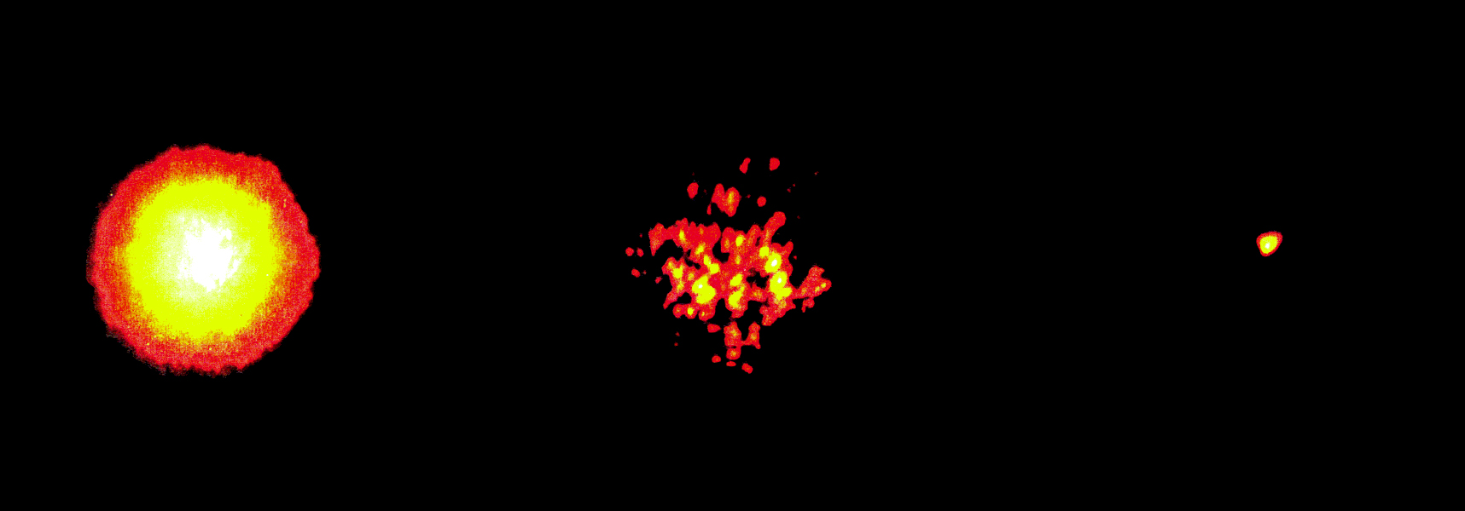
Why do astronomers need AO?
Three images of a bright star:
Lick Observatory, 1 m telescope
Long exposure
image
Short exposure
image: “speckles”
With adaptive optics
If image of a star is very small, your telescope will also be able to see fine details of galaxies, star clusters, ...
Notes:
1

Slide 2
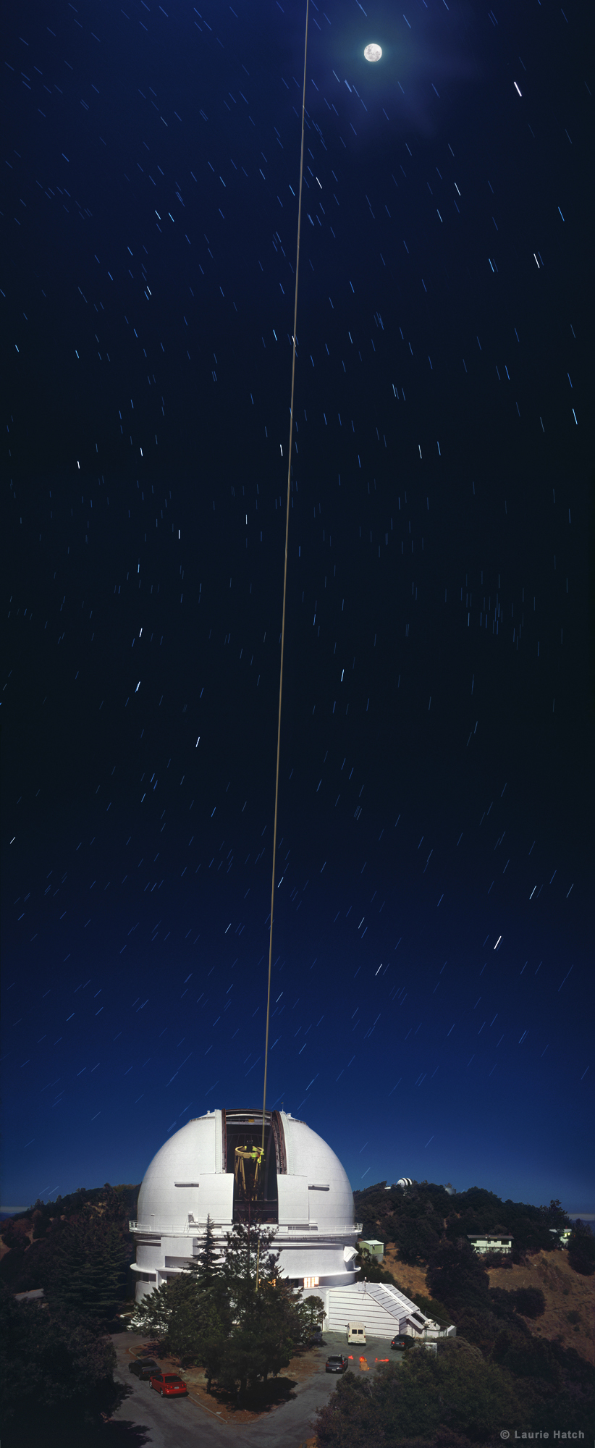
UC and Adaptive Optics
UC and UCO have led the way in AO for astronomy
3m laser-guide star AO first to be put in use
Keck is (by far) the leader in AO science productivity
$9.3M gift from the Moore Foundation for the Lab for Adaptive Optics at Santa Cruz
$40M NSF Science and Technology Center at UCSC

Slide 3
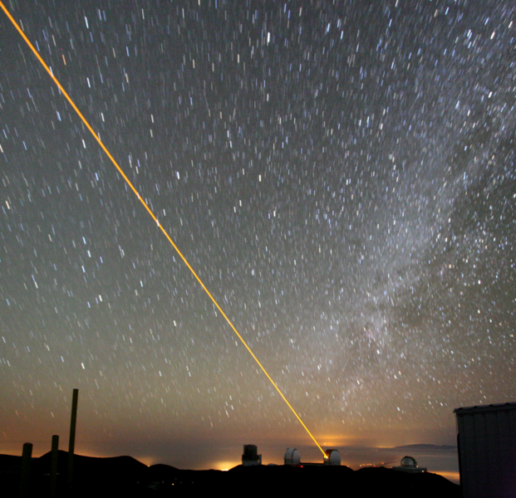
Keck Observatory Laser Guidestar

Slide 4

Neptune (Keck AO)

Slide 5
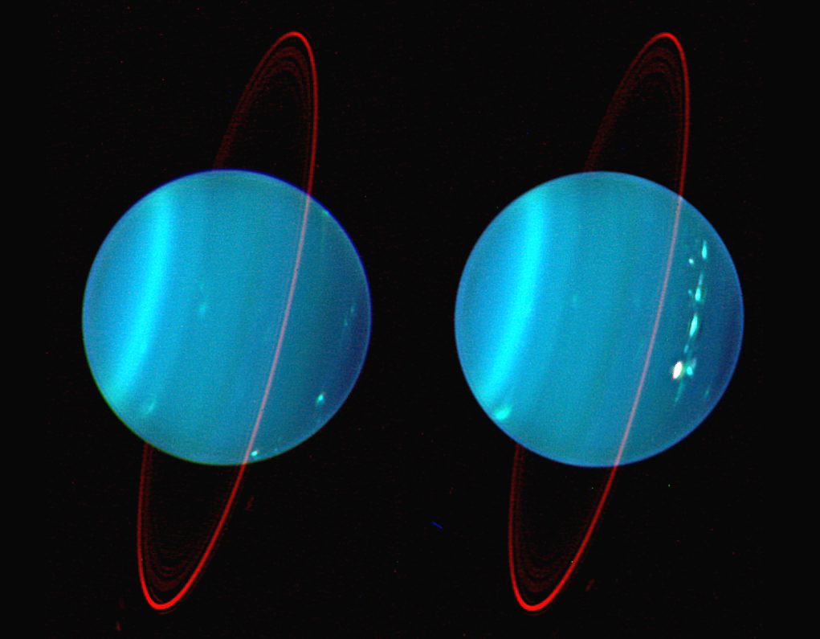
Neptune (Keck AO)

Slide 6

Galactic Center (Keck AO)

Slide 7
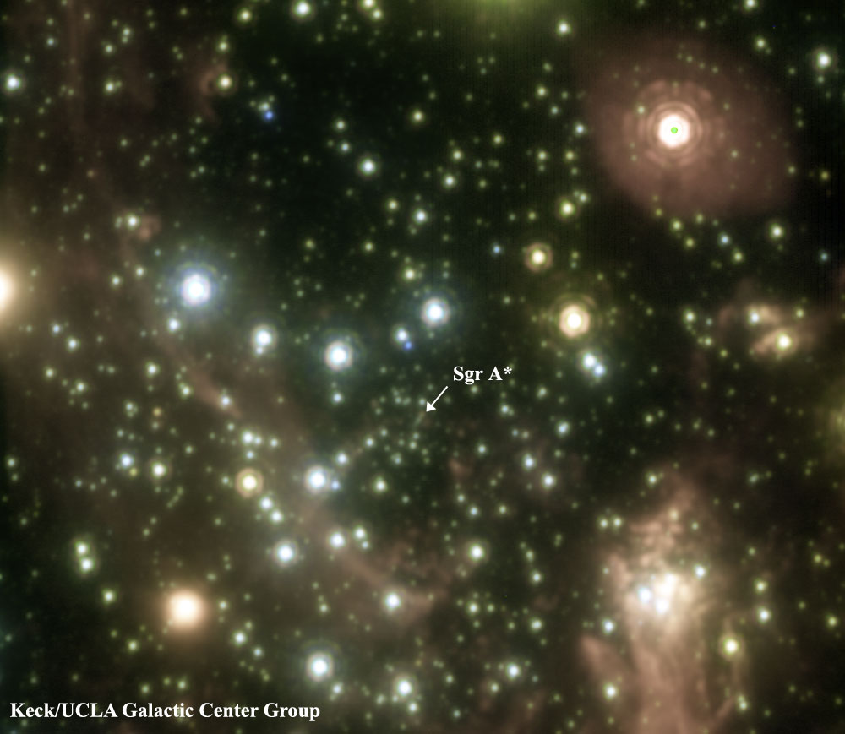
Galactic Center (Keck AO)

Slide 8
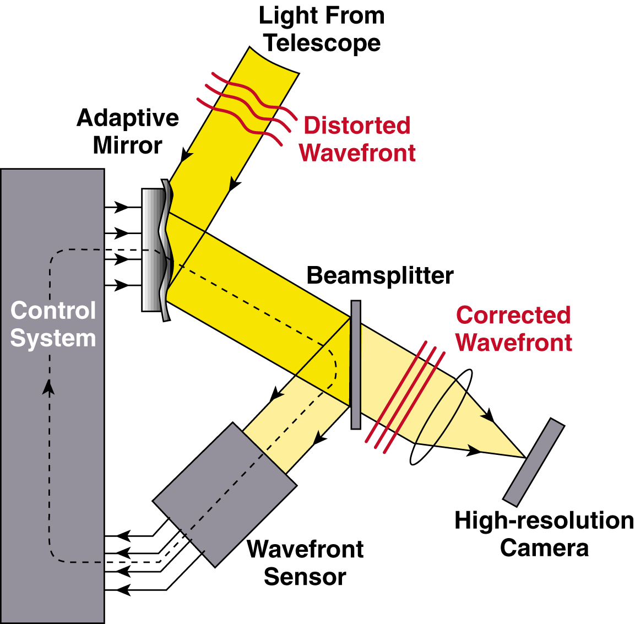
How Adaptive Optics Works
Invert the wavefront aberration with an “anti-atmosphere” (deformable mirror)
Feedback loop: next cycle corrects the (small) errors of the last cycle
or other astronomical
instrument
Notes:
8

Slide 9
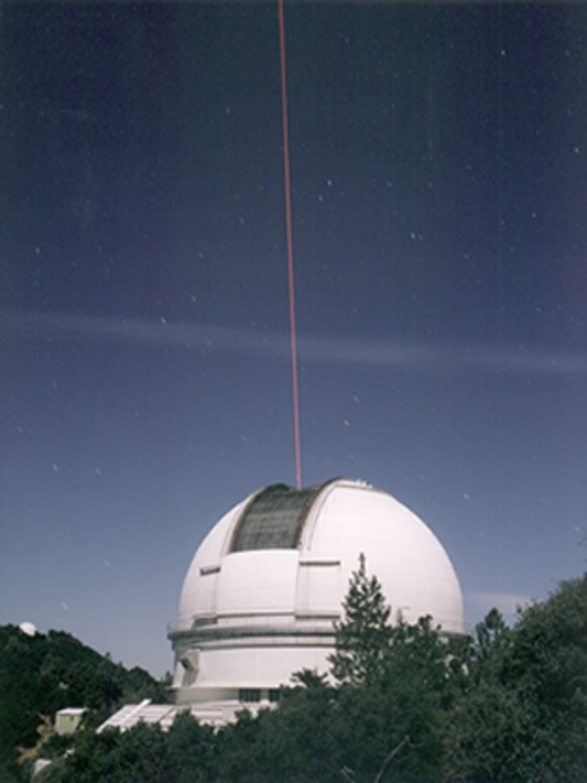
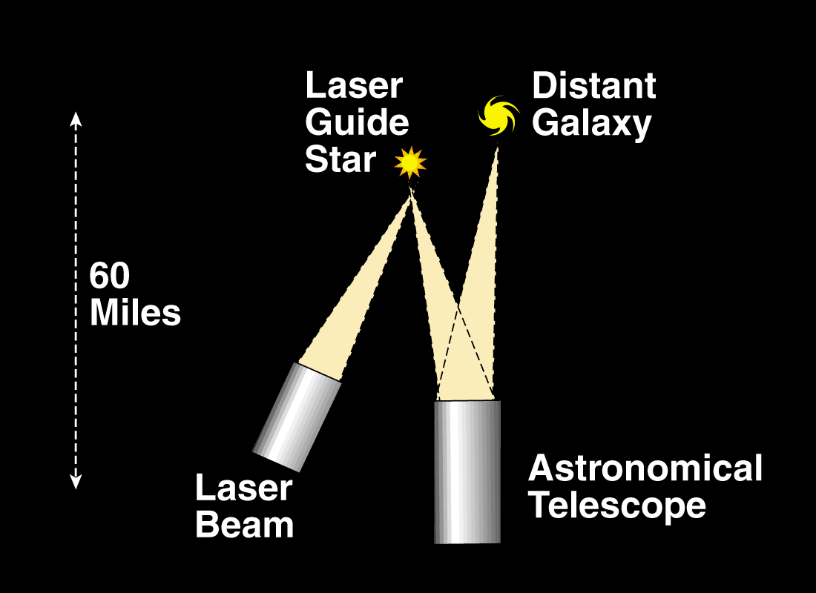
If there is no nearby star, make your own “star” using a laser
Concept
Implementation
Lick Obs.
Notes:
9

Slide 10
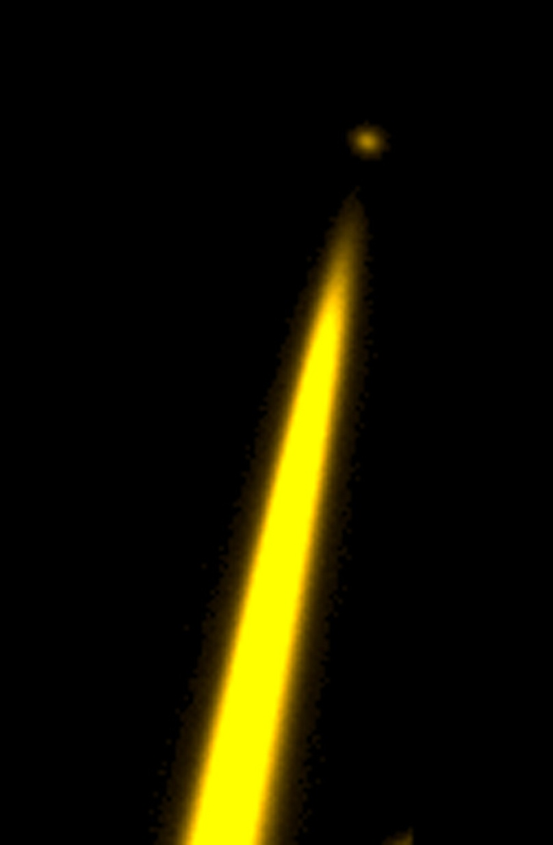
Anatomy of a Laser Guide Star
The Guide Star: Fluorescent scattering by the mesospheric Sodium layer at ~ 95 km
Maximum altitude of (unwanted) backscatter from the air ~ 35 km
Back scatter from air molecules
Lick Obs.
Notes:
10

Slide 11
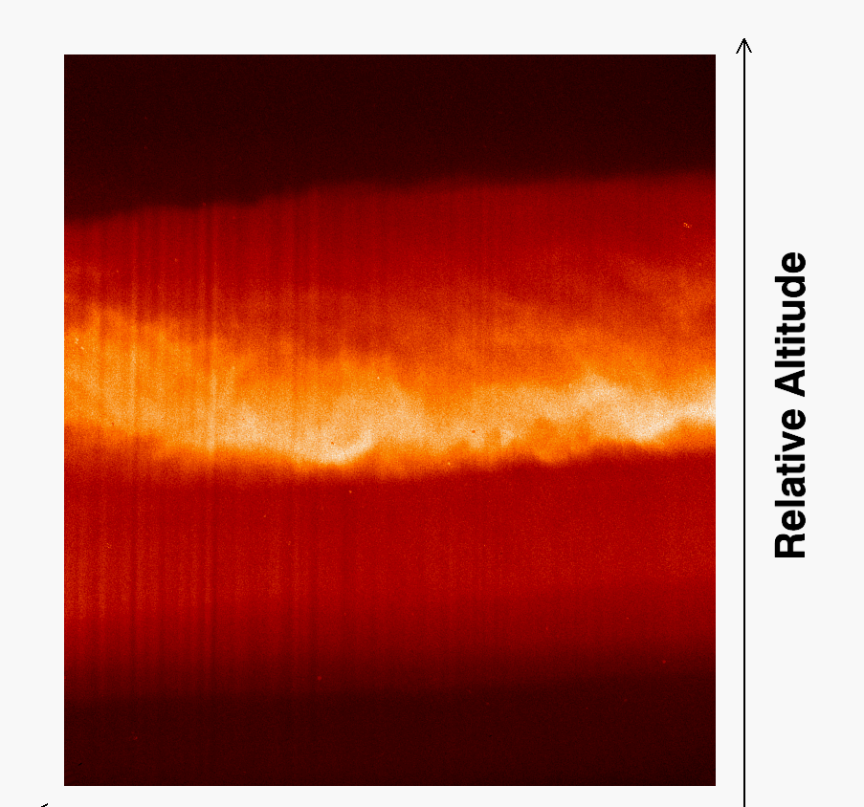
Laser Guidestar Structure in the Sodium Layer
26.8 m
90 km
Pixel size=0.36”
Nickel, 1m
600 m
Shane, 3m
Figure 9. Variation of the mesospheric sodium density as a function of time and altitude was measured using the Lick Observatory Shane Telescope sodium laser. Drift-scan images from the Nickel, 600 meters to the west, enable us to resolve time and altitude dependence.
Lick Obs.
Notes:
11

Slide 12
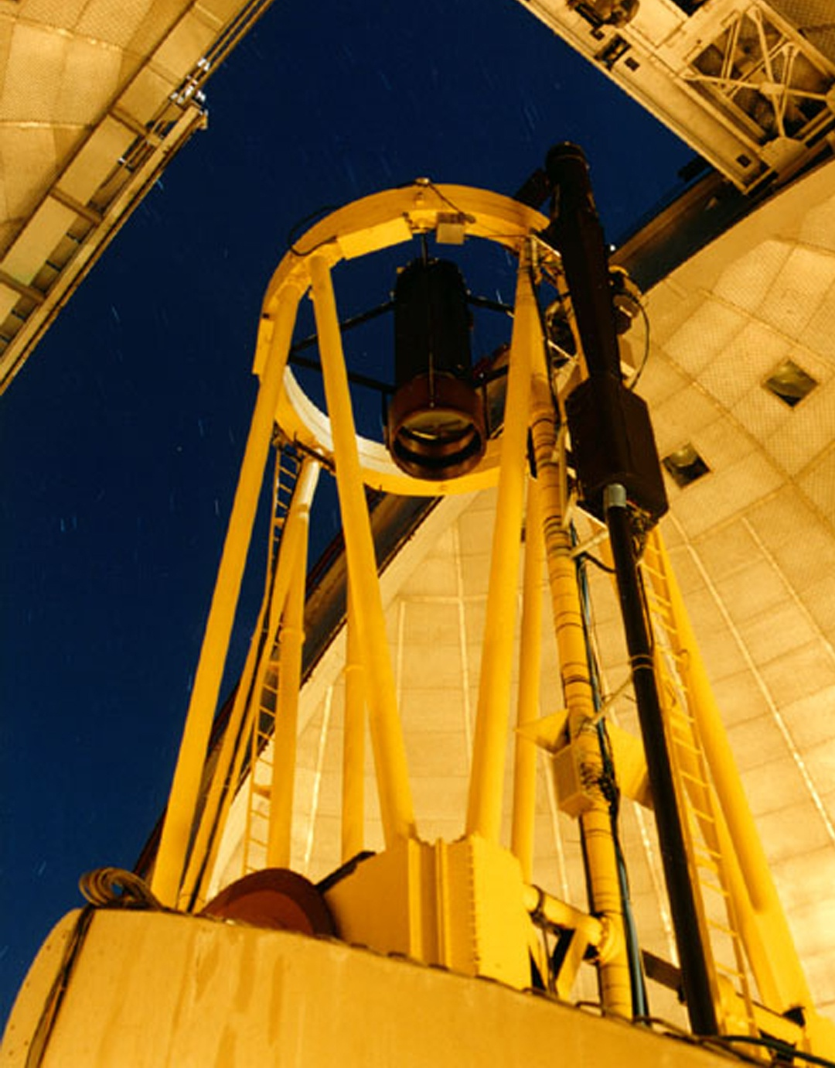
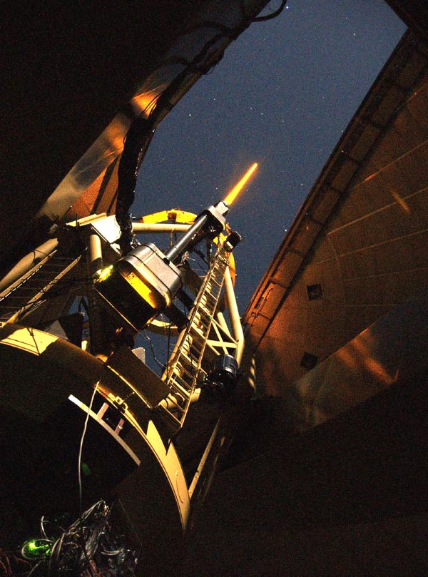
Laser system on the Shane Telescope
Lick Observatory, Mt Hamilton, CA
D. Whysong
Notes:
12

Slide 13
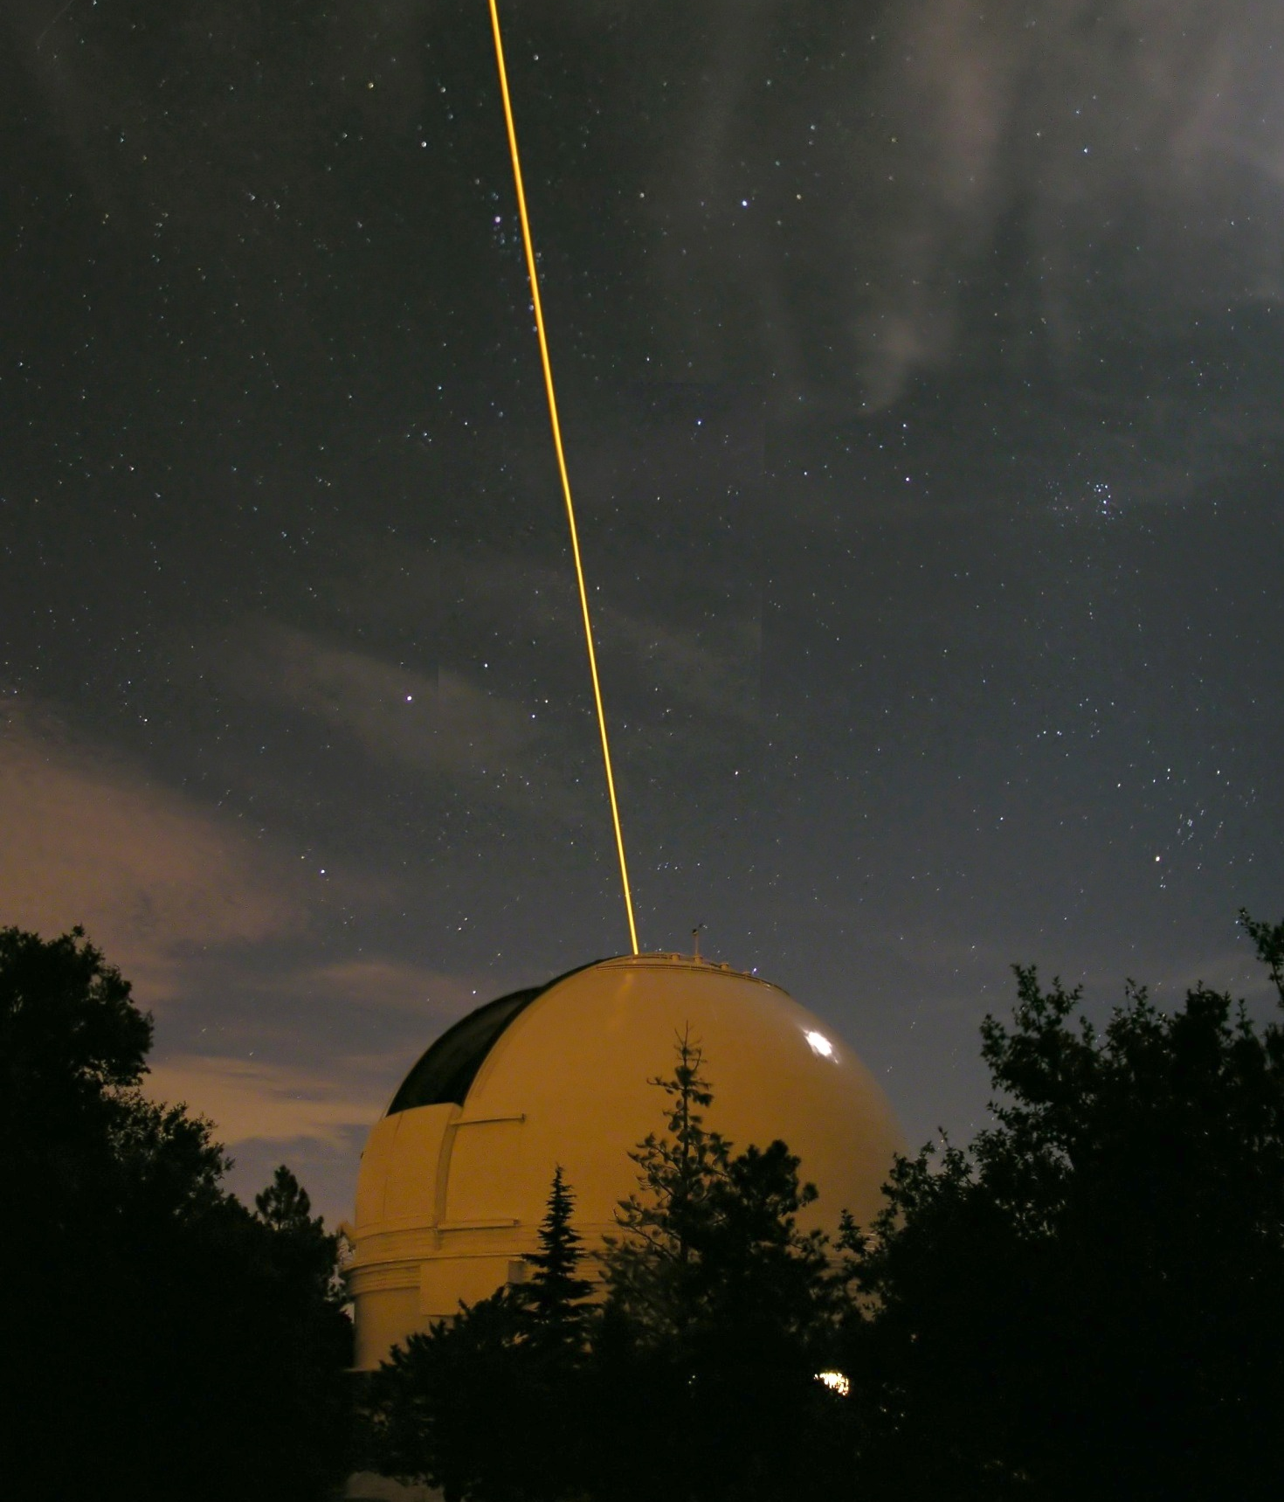
LICK LASER
Mt. Hamilton
Photo: Marshal Perin
Notes:
13

Slide 14
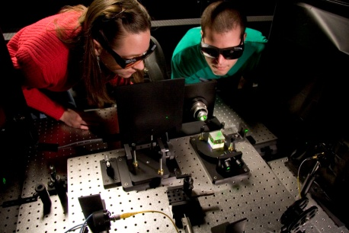
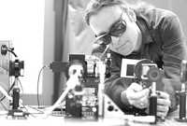
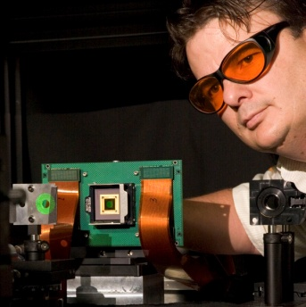
Laboratory for Adaptive Optics
Claire Max, Principal Investigator
Joseph Miller, co-Investigator
Jerry Nelson, co-Investigator
Donald Gavel, Laboratory Director
A permanent facility within the UCO/Lick Observatory located at the UC Santa Cruz campus
Presently funded by a grant from the Gordon and Betty Moore Foundation
LAO Goals
Develop Adaptive optics technology and methods for the next generation of extremely large ground-based telescopes
Develop and build a planet finder instrument using “extreme” adaptive optics technology
3. Develop, test, and evaluate new components and key technologies for adaptive optics
4. Provide a laboratory where students and postdocs will be trained in adaptive optics design, modeling, and implementation
Notes:
14

Slide 15
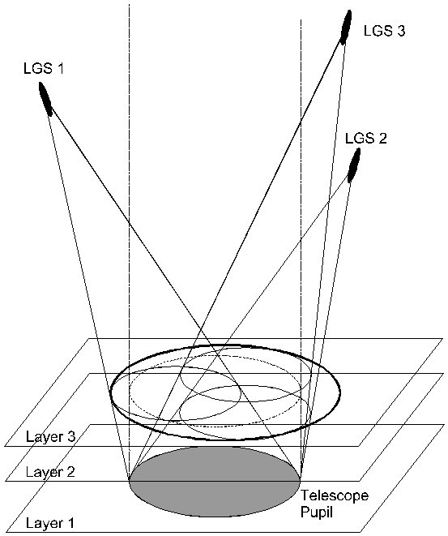
Next Generation Adaptive Optics
Multiple Guidestar Tomography + Volume Correction = MCAO
Notes:
15

Slide 16
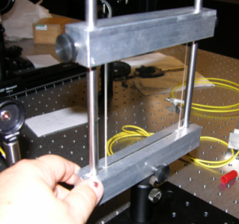
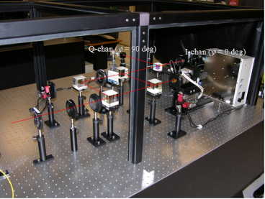
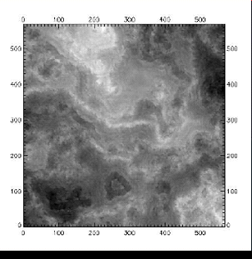
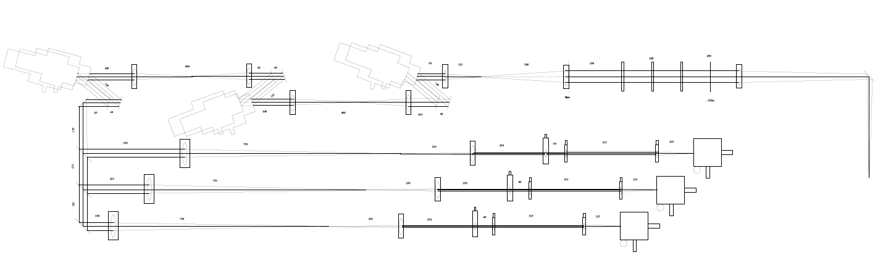
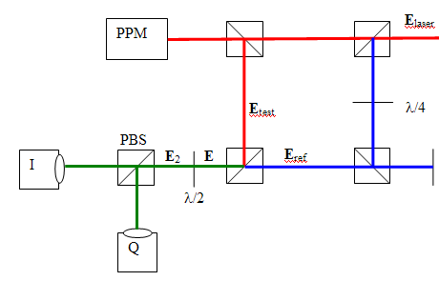
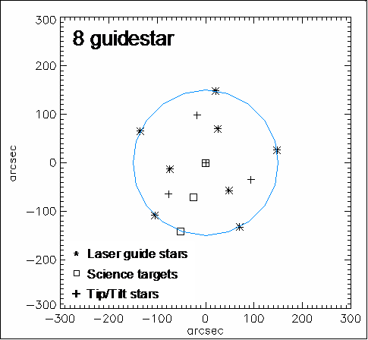
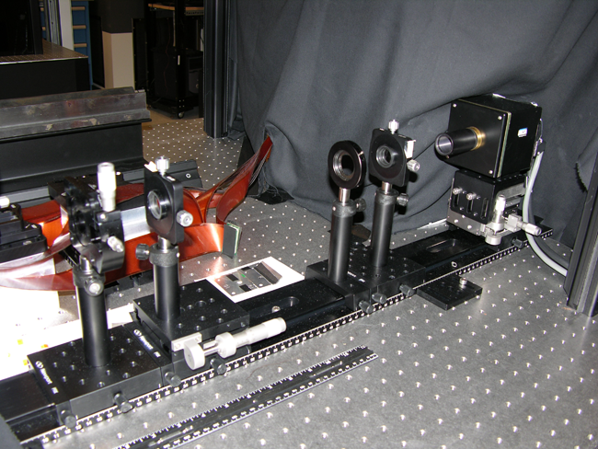
MCAO / MOAO Testbed
Deformable Mirrors (SLMs)
Kolmogorov Atmosphere phase aberrator plates
QPI Interferometer
Interferometer reference beam
Open loop WFS path
Ref Flat
SLM
NGS
LGS
Guide star fibers
Far Field Camera
Up to 8 wavefront guide stars and 4 tip/tilt stars
10,000 DOF per DM (100x100 subaperture Hartmann sensors)
Up to 3 DMs (MCAO) or 1 DM and open loop WFS path (MOAO)
5 Hz sample & control rate
Moving phase plates (wind)
Moving LGS fibers in z to simulate LGS elongation, or laser pulse
Configurable guide star constellation
Hartmann Wavefront Sensors

Slide 17


Adaptive Optics System and Infrared Instrumentation for the Shane 3-meter Telescope
UCO/Lick Observatory
University of California
Presented to the UCOAC Meeting May 6, 2012
Laboratory for Adaptive Optics
UCO/Lick Observatory

Slide 18
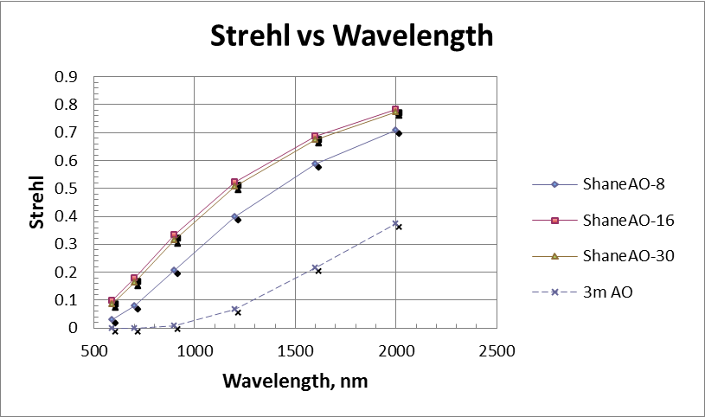
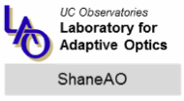
ShaneAO expected performance
LGS mode, new fiber laser
Airy core forming

Slide 19
ShaneAO Technology development connection to Keck NGAO
MEMS deformable mirror
Fiber laser tuned to atomic sodium transitions (optical pumping, re-pump line)
Control system: woofer-tweeter, wind-predictive
Other opto-mechanical stability design improvements
In the next few years, ShaneAO is the *only LGS-AO system* being planned (in the world) that will have the kind of low wavefront errors being contemplated by TMT NFIRAOS.
Thus ShaneAO is a TMT pathfinder in the system performance aspect, in addition to in the individual components.

Slide 20
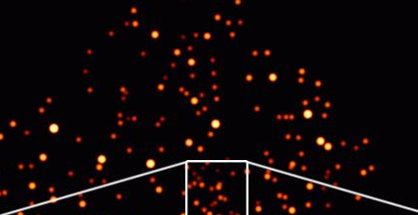
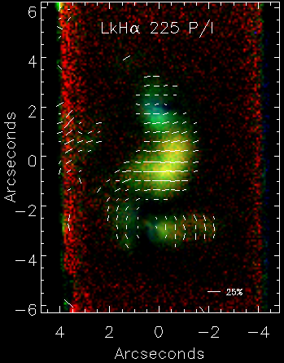
ShaneAO Science Application
Crowded field imaging:
Star counts, metallicity and ages in clusters within our Galaxy
Star counts in Andromeda galaxy
Astrometry – tracking the orbits of stellar companions
Detailed imaging of nebula and galaxies
Gas and dust disks around young stars
Multiple star systems in star forming regions
Velocity dispersion of galaxies hosting active galactic nuclei
Morphological detail of quasar host galaxies
Details of morphology of merging galaxies
Exoplanets and planet formation statistics
Follow up to radial velocity planetary systems (stellar companions)
Follow up to Kepler survey stars (companions)
Precursory work for Gemini Planet Imager target stars
Solar system
Composition and orbital parameters of Kuiper belt objects
Composition and orbital parameters of asteroids and asteroid moons
Details of gas-giant ring structure and positions of ring-shepherding moons
Details and evolution of gas-giant weather
Star-forming regions - polarimetry

Slide 21
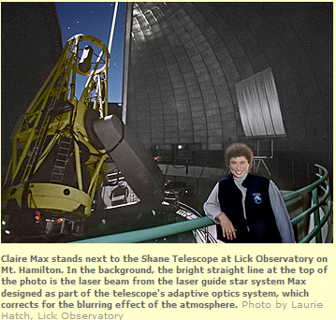

Slide 22
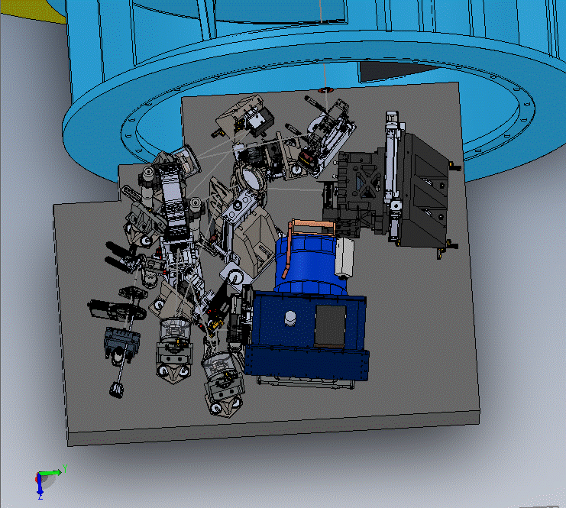
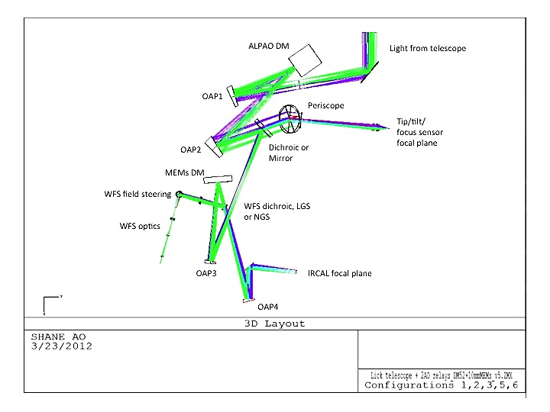
Optomechanical Architecture
Cassegrain mount
“Woofer-tweeter” architecture
  Closed-loop AO
  Partially corrected TT star

Slide 23
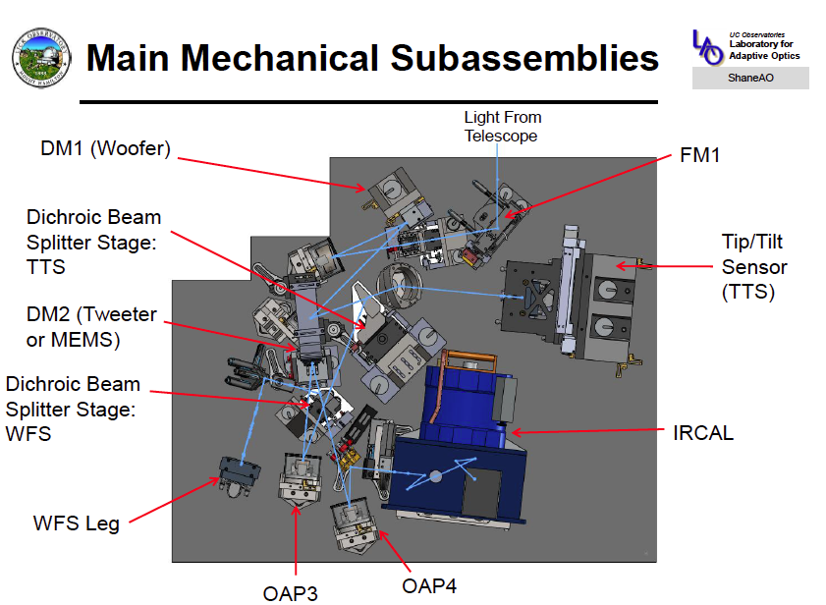

Slide 24
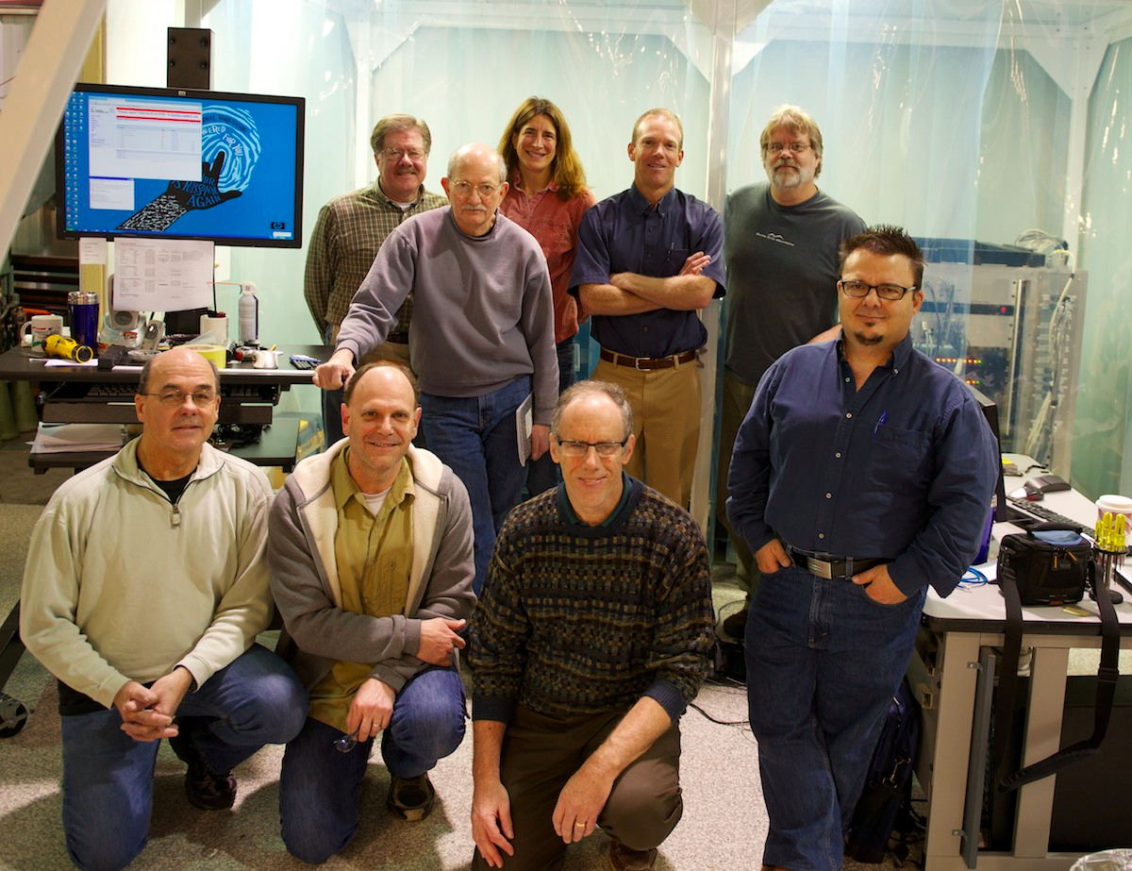
ShaneAO Engineering Team
In the high bay of the Lick Optical Shops
During ShaneAO assembly, February, 2014

