Slide 1
Planets in Binary Systems Searching for High Contrast Binaries with ShaneAO
Lea Hirsch
3rd Year Graduate Student
UC Berkeley Department of Astronomy
lhirsch@berkeley.edu
ShaneAO Workshop • Dec 17, 2014 at UCSC Lea Hirsch • UC Berkeley
Notes:
Hi, Lea Hirsch, 3rd year grad student with GM
Thesis project on planets in binaries
Goal is to characterize the occurrence rate and props of planets in binaries vs. those in single systems
how does a binary companion impact planet formation/evolution?
Brief intro on project, then dive into specifics of looking for high contrast binary systems with ShaneAO

Slide 2
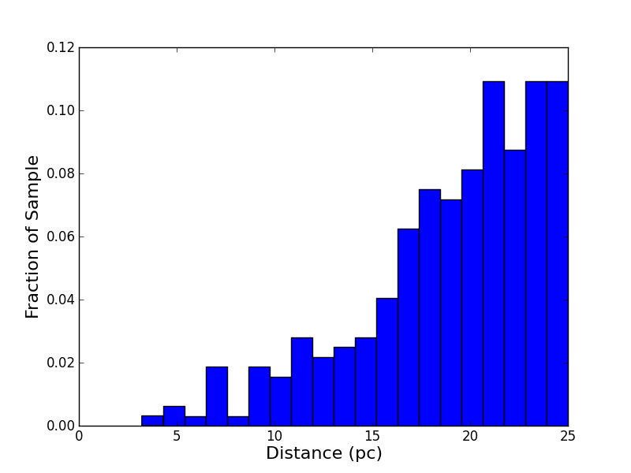
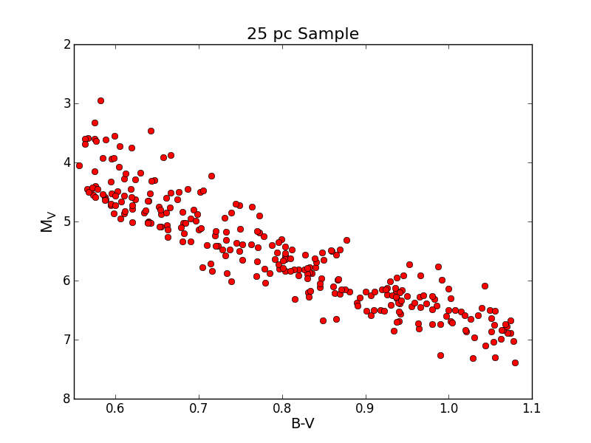
Project Overview
25 pc Volume-Limited Stellar Sample:
0.55 < B-V < 1.1 (F8 – K5)
Within +/- 1 M_{V} of Main Sequence
Distance < 25 pc
Declination > -10°
ShaneAO Workshop • Dec 17, 2014 at UCSC Lea Hirsch • UC Berkeley
Notes:
Method is selecting volume limited sample of nearby sunlike stars, performing dual survey with ShaneAO and KeckHIRES/ APF for spectroscopic followup, searching for both planetary and stellar companions orbiting the primary stars in the sample.
Ultimate goal is Binary vs. Single, and correlations between planet props and binary props for planets in binaries
Sample: started with Hip, made cuts in prlax, color, distance from MS to get F8-K5 stars on MS within 25 pc.
~300 stars
Following up with image and spectroscopy

Slide 3
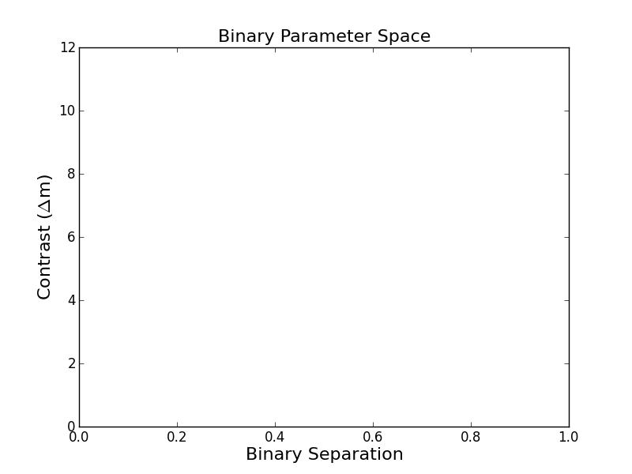
Science Goals
SB1
HIRES
ShaneAO
K_{s} band
RV Trends
(But no orbital solutions or companion masses)
SB2
(Kolbl+ 2014)
CHARA interferometry (Raghavan 2010)
V band
RoboAO
(Riddle+ 2014)
i’ band
(arcsec)
ShaneAO Workshop • Dec 17, 2014 at UCSC Lea Hirsch • UC Berkeley
Notes:
Couple of multiplicity surveys in past:
Rag 10… CHARA interferometry gives excellent inner working angles (100th “), but limited in contrast
RoboAO survey just published to arxiv, contrast curve taken from this work also covers low contrast regime very well.
Using spectroscopy, can find SB2 systems with ReaMatch

Slide 4
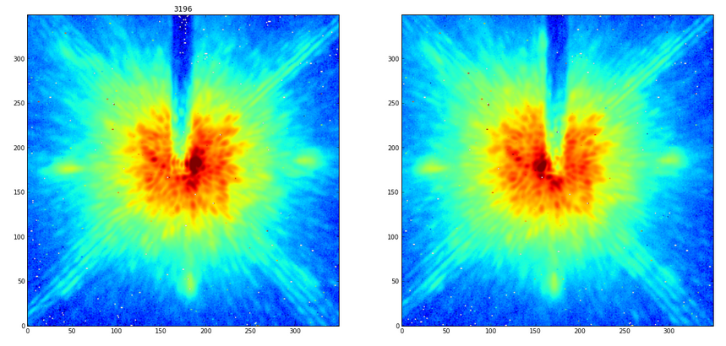
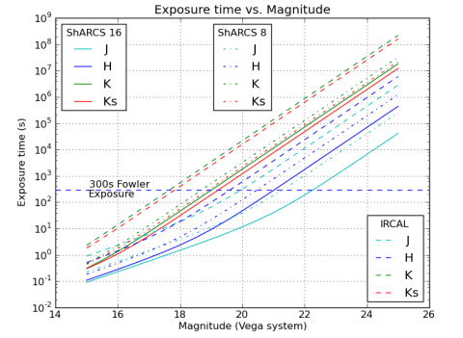
ShaneAO Methodology
Finger
E - W orientation of finger
K_{s} filter
3 x 30-second integrations per position
5 x 30-second skies per star
Srinath+ 2014
ShaneAO Workshop • Dec 17, 2014 at UCSC Lea Hirsch • UC Berkeley
Notes:
Trying to achieve high contrast by sacrificing inner working angle using the finger
To limit the amount of space covered by the finger, using a 2-position observing technique where I offset star slightly E and then slightly W of finger
see image
Observing in Ks, exposure times, skies (since I can’t dither)
In 90 second combined images, get to S/N~5 for Kmag < 18. Way past the bottom of the main sequence, into BD regime for systems within 25 pc
so can find any and all stellar companions and possibly some young BDs if they exist.
The complication that comes in can be seen in this image, underlying speckle structure becomes very bright when you expose for a long time on a very bright star. Speckles are quasi-static, and are probably in your images as well but occulting the core of PSF makes them much easier to see.
Very interested in soliciting your ideas on what is causing these quasi-static speckles… don’t smooth out over long exposures, so not atmospheric?

Slide 5
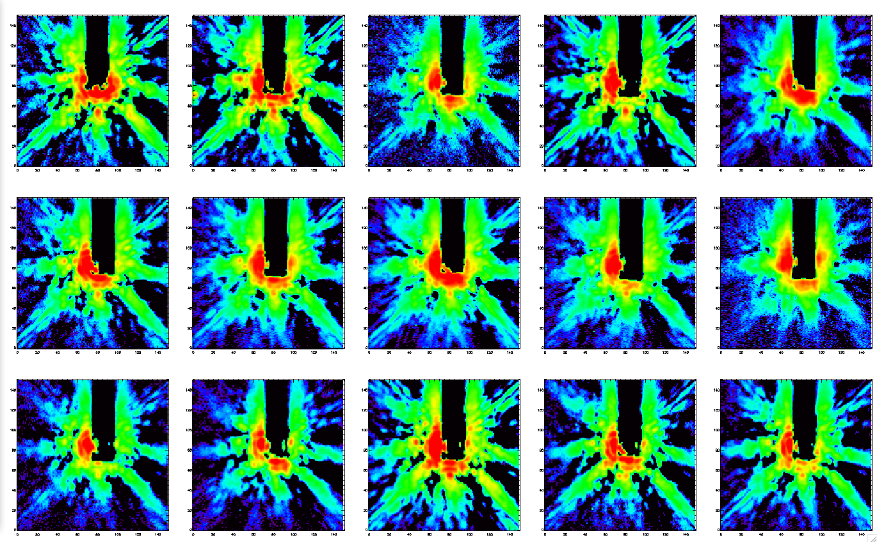
Speckle Structure
July 16, 2014
HIP 64979
HD 130948
HD 131582
HD 143761
HD 144287
HD 155712
HD 182488
HD 190360
HD 190404
HD 198425
HIP 103256
HD 208038
HD 215648
HIP 116611
HIP 1473
ShaneAO Workshop • Dec 17, 2014 at UCSC Lea Hirsch • UC Berkeley
Notes:
To study more, have plotted all images from one night, July 16. High-pass filtered by subtracting median-smoothed version with large box size, just to bring small-scale structure out
Can see some fairly persistent speckles: bottom, left double
Can also see where correction was poorer and uncorrected halo overwhelms speckles
Notice that some speckles come and go while others are very persistent . Ideas?

Slide 6
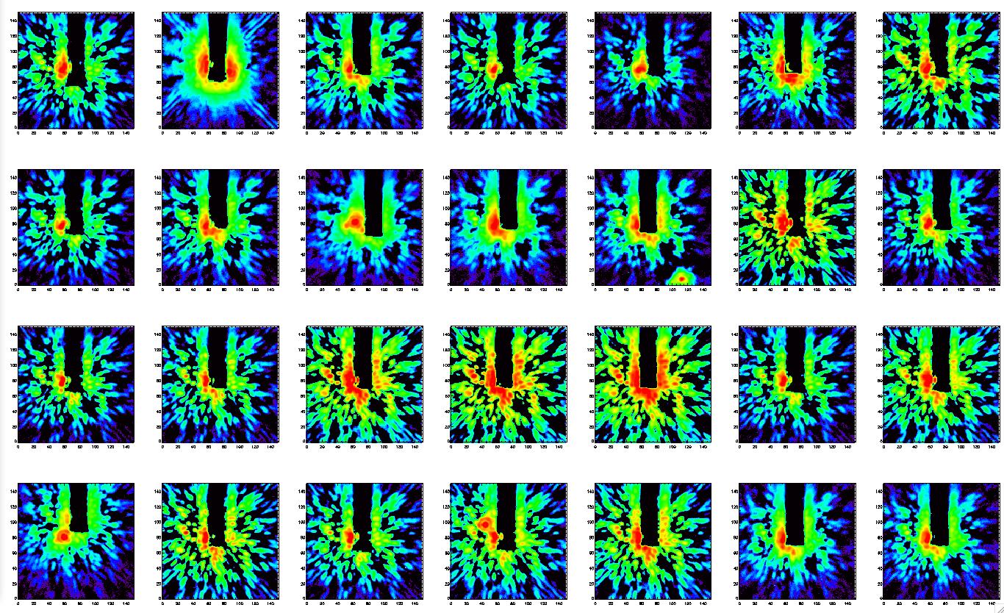
Speckle Structure
Nov 4, 2014
HIP 103298
HIP 104521
HD 210277
HD 217813
HD 1160
HD 1461
HD 3196
HD 4356
HD 4915
HD 6101
HD 10008
HD 13798
HD 16160
HD 16287
HD 18632
HD 20619
HD 20630
HD 22484
HD 26965
HD 26913
HD 32147
HD 35112
HD 38858
HD 42618
HD 43587
HD 50281
HD 52919
HD 60491
ShaneAO Workshop • Dec 17, 2014 at UCSC Lea Hirsch • UC Berkeley
Notes:
Here’s another night. Eastern bright speckle still there, though I haven’t had a chance to check if it is in the same position as in July…
Trio of bright eastern speckles, sometimes in line, sometimes not
Problem is that these could easily hide a star. If they were very static, wouldn’t be a problem, could model them away, but not…

Slide 7
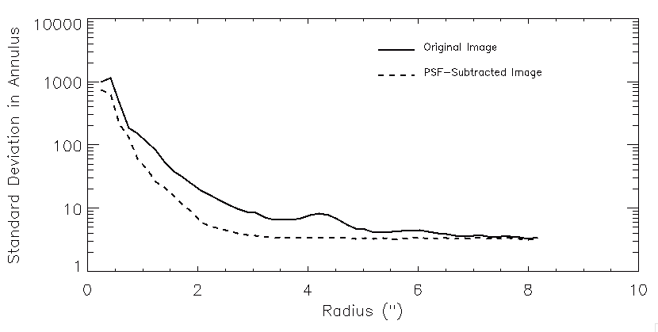
LOCI Algorithm
Lafrenière+ 2007
HD 131582
PSF reconstruction from reference images
all images from same night
reconstruct small “optimization regions” as weighted sum of reference images
ShaneAO Workshop • Dec 17, 2014 at UCSC Lea Hirsch • UC Berkeley
Notes:
Way I’ve been dealing is writing a code to implement the LOCI algorithm, method of reconstructing psf by weighted sum of set of reference images, in this case other images from same night. Basically go through image in small chunks called optimization regions and build up PSF image that best matches your target star.
Example for hd 131582: left, center, right.
Plotted stdev within 5 pixel annuli
Why do the speckles come and go at given locations? Optics? Loop? Seeing? Turbulent spectrum of atmosphere?
Way to make speckles more consistent?

Slide 8
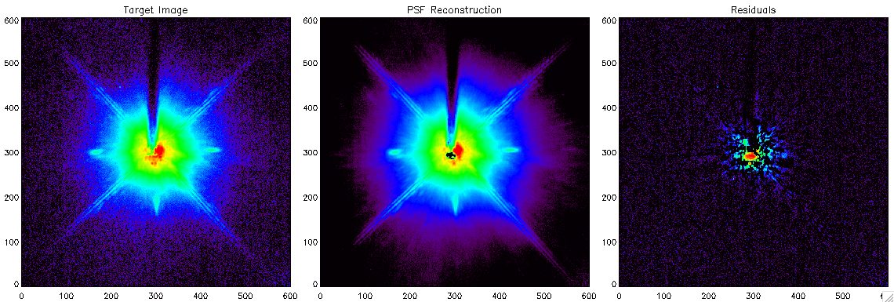
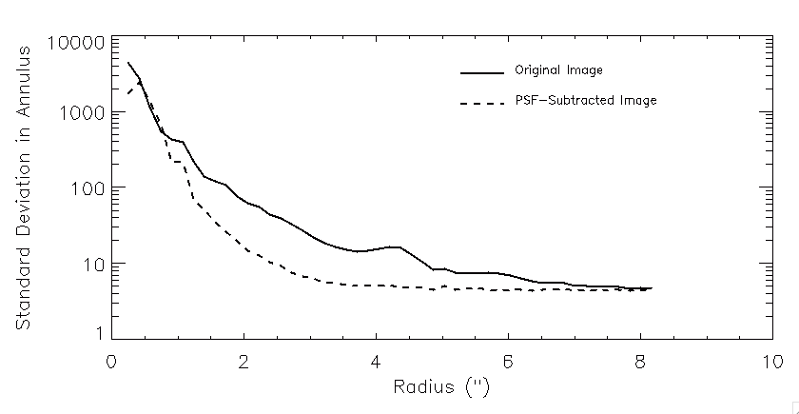
LOCI Algorithm
HIP 116611
PSF reconstruction from reference images
all images from same night
reconstruct small “optimization regions” as weighted sum of reference images
ShaneAO Workshop • Dec 17, 2014 at UCSC Lea Hirsch • UC Berkeley
Notes:
Another example of star from before with known companion
Why do the speckles come and go at given locations? Optics? Loop? Seeing? Turbulent spectrum of atmosphere?
Way to make speckles more consistent?

Slide 9
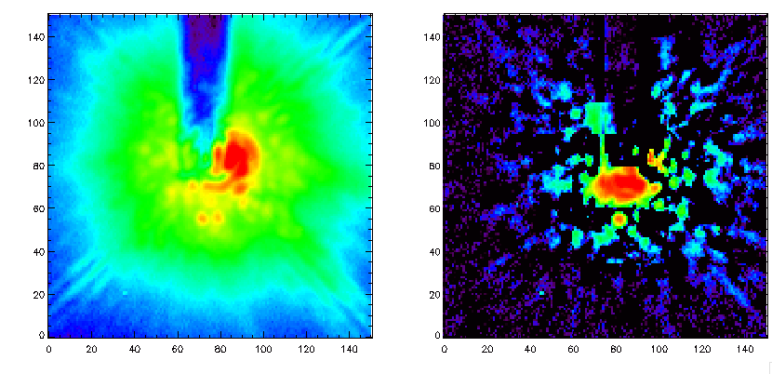
LOCI Algorithm
HIP 116611
PSF reconstruction from reference images
all images from same night
reconstruct small “optimization regions” as weighted sum of reference images
ShaneAO Workshop • Dec 17, 2014 at UCSC Lea Hirsch • UC Berkeley
Notes:
Zoom in on original image and subtracted image, can see the star
Why do the speckles come and go at given locations? Optics? Loop? Seeing? Turbulent spectrum of atmosphere?
Way to make speckles more consistent?
Static speckles should subtract away
Infrequent speckles vs. stars

Slide 10
Future Outlook
Improve LOCI code
Astrometry : using diffraction spikes to accurately determine stars’ locations
Return to these systems next year to check common proper motion for any faint companions detected
ShaneAO Workshop • Dec 17, 2014 at UCSC Lea Hirsch • UC Berkeley

Slide 11
Final Questions
Why is the appearance of the speckles different from one hour/night to the next?
Can ShaneAO be optimized to minimize the speckles?
Is there a better algorithm than LOCI to carry out PSF reconstruction and reveal faint companions?
ShaneAO Workshop • Dec 17, 2014 at UCSC Lea Hirsch • UC Berkeley

