Slide 1
Toward < 0.1% Accuracy with AO Polarimetry
Sloane Wiktorowicz
December 17, 2014
ShaneAO Workshop

Slide 2
AO Polarimetry Limited by Waveplates
Want high wavefront quality in AO optics
Want uniform retardance in polarimeter (spatially & spectrally)
Cannot simultaneously have high wavefront quality (flat surface) and uniform retardance (waveplate coating thickness)
Low wavefront quality: waveplate downstream of AO system, experiencing instrumental circular polarization (reflections)
Non-ideal retardance: sensitivity to circular polarization
GPI: 5% instrumental circular polarization x 10% sensitivity = 0.5% crosstalk between linear and circular polarization
GPI: 0.1% accuracy due to parallactic angle rotation, not possible with Shane 3-m (Wiktorowicz et al. 2014, SPIE)

Slide 3
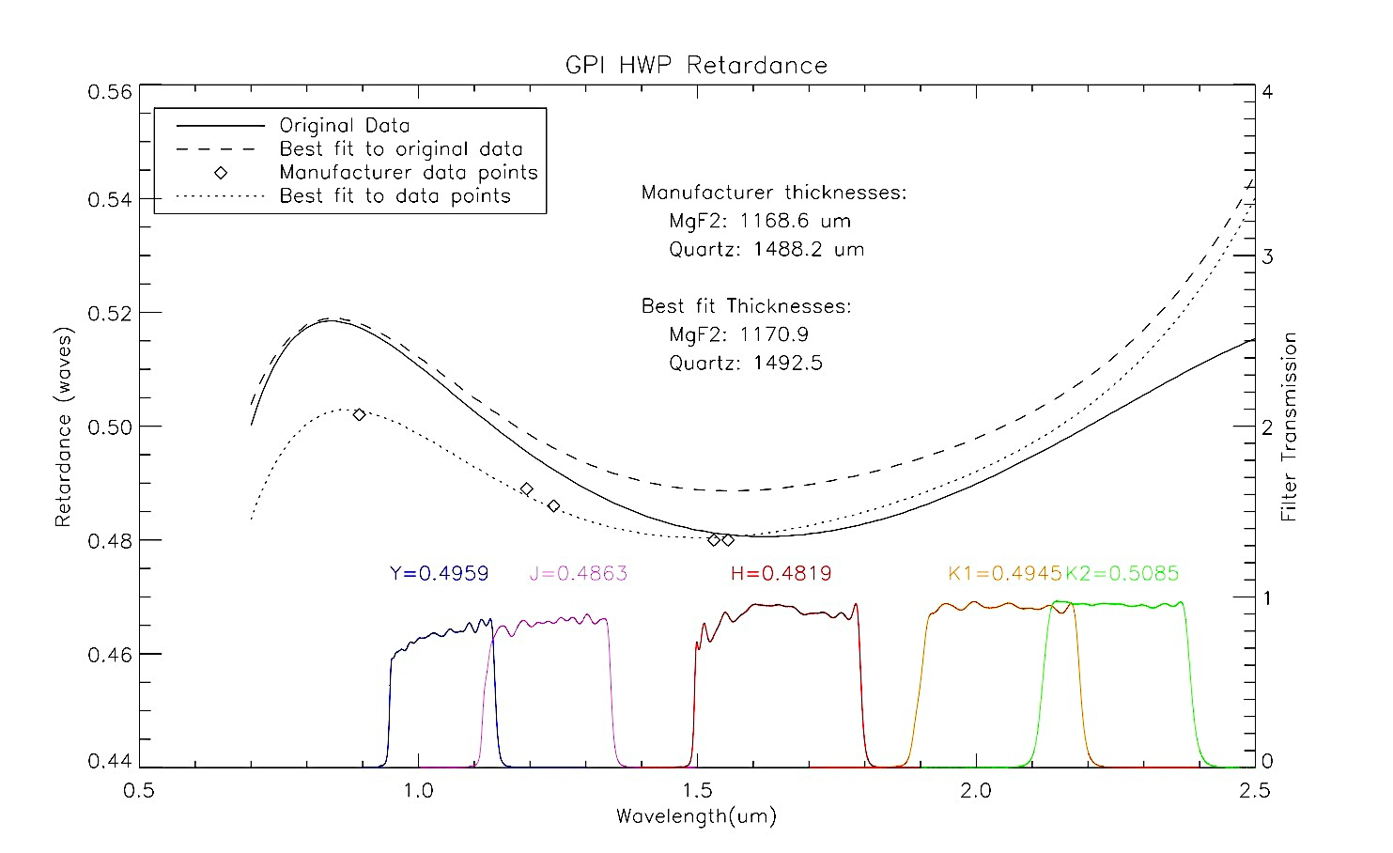
GPI Half-Wave Plate

Slide 4
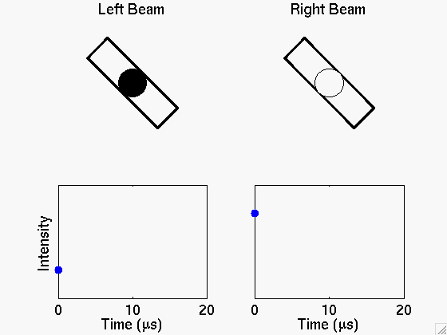


Slide 5
Photoelastic Modulators
Retardance from stress birefringence, not coating
Bar of fused silica or CaF₂, can give high wavefront quality
Locate upstream of fold mirror in ShaneAO to minimize instrumental polarization
Imaging: Use Wollaston in filter wheel
Spectropolarimetry: Add beam displacer just downstream of modulators, use grism in filter wheel?
Move detector up and down in phase with modulation (~1 Hz) and integrate, gives 4 spots per point source
No sensitivity to circular polarization

Slide 6
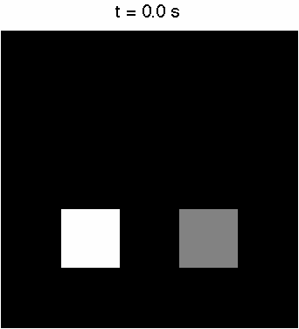
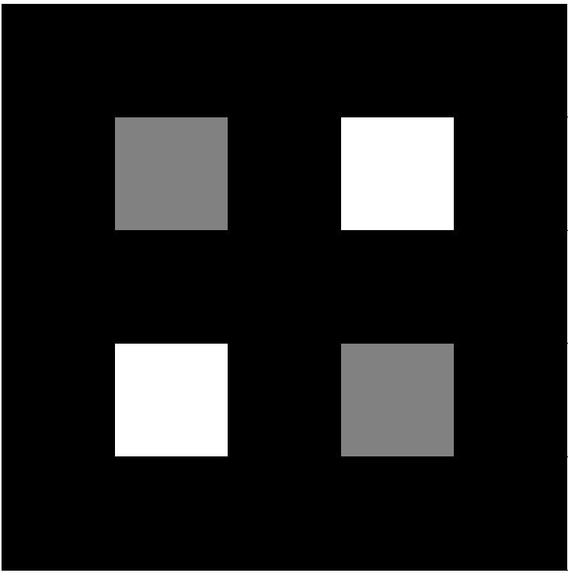

Photoelastic Modulators
Wollaston spots

Slide 7
Conclusion
AO waveplate polarimeters limited to ~0.1% accuracy (at alt-az), or ~0.5% accuracy (at equatorial, like ShaneAO)
Photoelastic modulators at Shane AO may allow order of magnitude improvement (< 0.1%), surpassing GPI
Science: Exoplanet thermal emission polarization (HR 8799b?), expected due to rotational oblateness (suggested in β Pic b) or patchy clouds (suggested in brown dwarfs)
Add 2 modulators (2 x $7k) upstream of fold mirror, allow detector to move in-phase with ~1 Hz modulation
Possible spectropolarimetry with new Wollaston in new location

